Slide 1

Deployment
Wenxuan Shi
College of Software, Nankai University
Email: shiwx@nankai.edu.cn
Wechat: 13920561100

Slide 2
Topics
Build and release an Android app
Build and release an iOS app
Build and release a web app

Slide 3
Build and release an Android app
Notes:
StatelessWidget is used for immutable elements that only rely on the object configuration information
StatefulWidget is used for elements that can dynamically change based on state-changes in the system
Everytime that state changes, setChange() is called by the object

Slide 4
Introduction
During a typical development cycle, you test an app using flutter run at the command line, or by using the Run and Debug options in your IDE.
By default, Flutter builds a debug version of your app.
Before publishing, you might want to put some finishing touches on your app.

Slide 5
Topics
Adding a launcher icon
Enabling Material Components
Signing the app
Shrinking your code with R8
Reviewing the app manifest
Reviewing the build configuration
Building the app for release
Publishing to the Google Play Store
Updating the app’s version number
Android release FAQ

Slide 6
Adding a launcher icon
When a new Flutter app is created, it has a default launcher icon.
To customize this icon, you might want to check out the flutter_launcher_icons package.

Slide 7
Enabling Material Components
If your app uses Platform Views, you may want to enable Material Components by following the steps described in the Getting Started guide for Android.

Slide 8
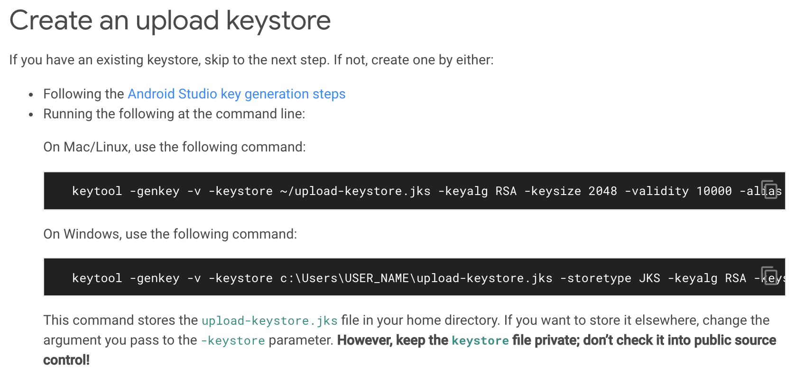
Signing the app
To publish on the Play Store, you need to give your app a digital signature.
Use the following instructions to sign your app.

Slide 9
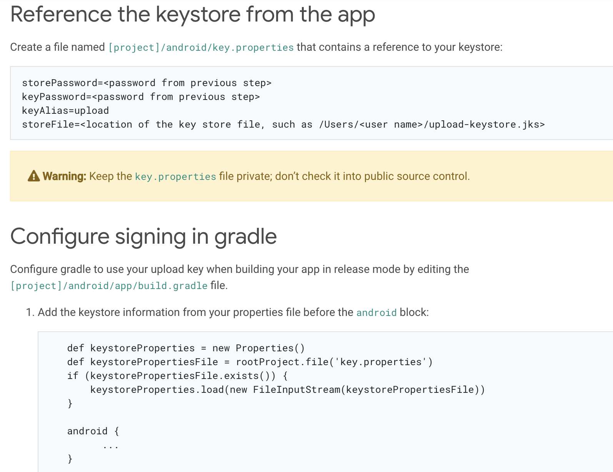

Slide 10
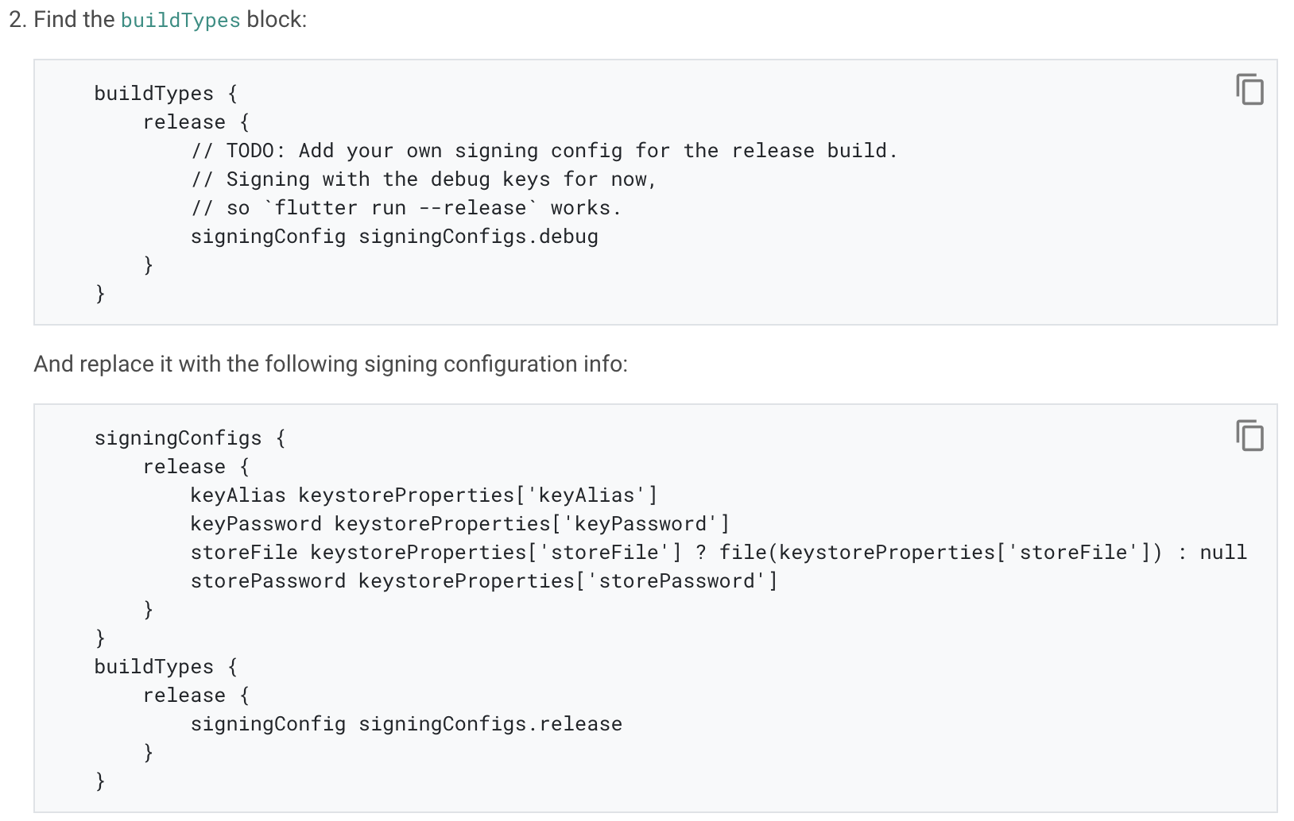

Slide 11
Shrinking your code with R8
R8 is the new code shrinker from Google, and it’s enabled by default when you build a release APK or AAB.
To disable R8, pass the --no-shrink flag to flutter build apk or flutter build appbundle.

Slide 12
Reviewing the app manifest
Review the default App Manifest file, AndroidManifest.xml, located in [project]/android/app/src/main and verify that the values are correct, especially the following::
Application: Edit the android:label in the application tag to reflect the final name of the app.
uses-permission : Add the android.permission.INTERNET permission if your application code needs Internet access.

Slide 13
Reviewing the build configuration
Review the default Gradle build file, build.gradle, located in [project]/android/app and verify the values are correct, especially the following values in the defaultConfig block:
applicationId
versionCode & versionName
minSdkVersion, compilesdkVersion, & targetSdkVersion

Slide 14
Building the app for release
You have two possible release formats when publishing to the Play Store.
App bundle (preferred)
APK

Slide 15
Build an app bundle
Enter cd [project]
Run flutter build appbundle (Running flutter build defaults to a release build.)
The release bundle for your app is created at [project]/build/app/outputs/bundle/release/app.aab.

Slide 16
Test the app bundle: An app bundle can be tested in multiple ways.
Offline using the bundle tool
If you haven’t done so already, download bundletool from the GitHub repository.
Generate a set of APKs from your app bundle.
Deploy the APKs to connected devices.
Online using Google Play
Upload your bundle to Google Play to test it.
Follow these steps to upload your bundle to the Play Store.

Slide 17
Build an APK
Although app bundles are preferred over APKs, there are stores that don’t yet support app bundles. In this case, build a release APK for each target ABI (Application Binary Interface).
If you completed the signing steps, the APK will be signed.

Slide 18
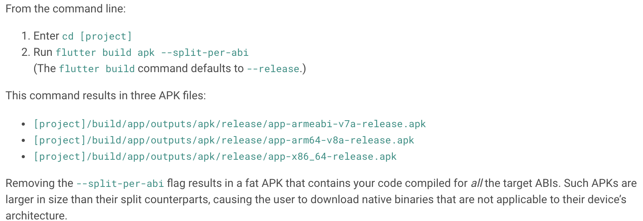

Slide 19
Install an APK on a device
Follow these steps to install the APK on a connected Android device.
From the command line:
Connect your Android device to your computer with a USB cable.
Enter cd [project].
Run flutter install.

Slide 20
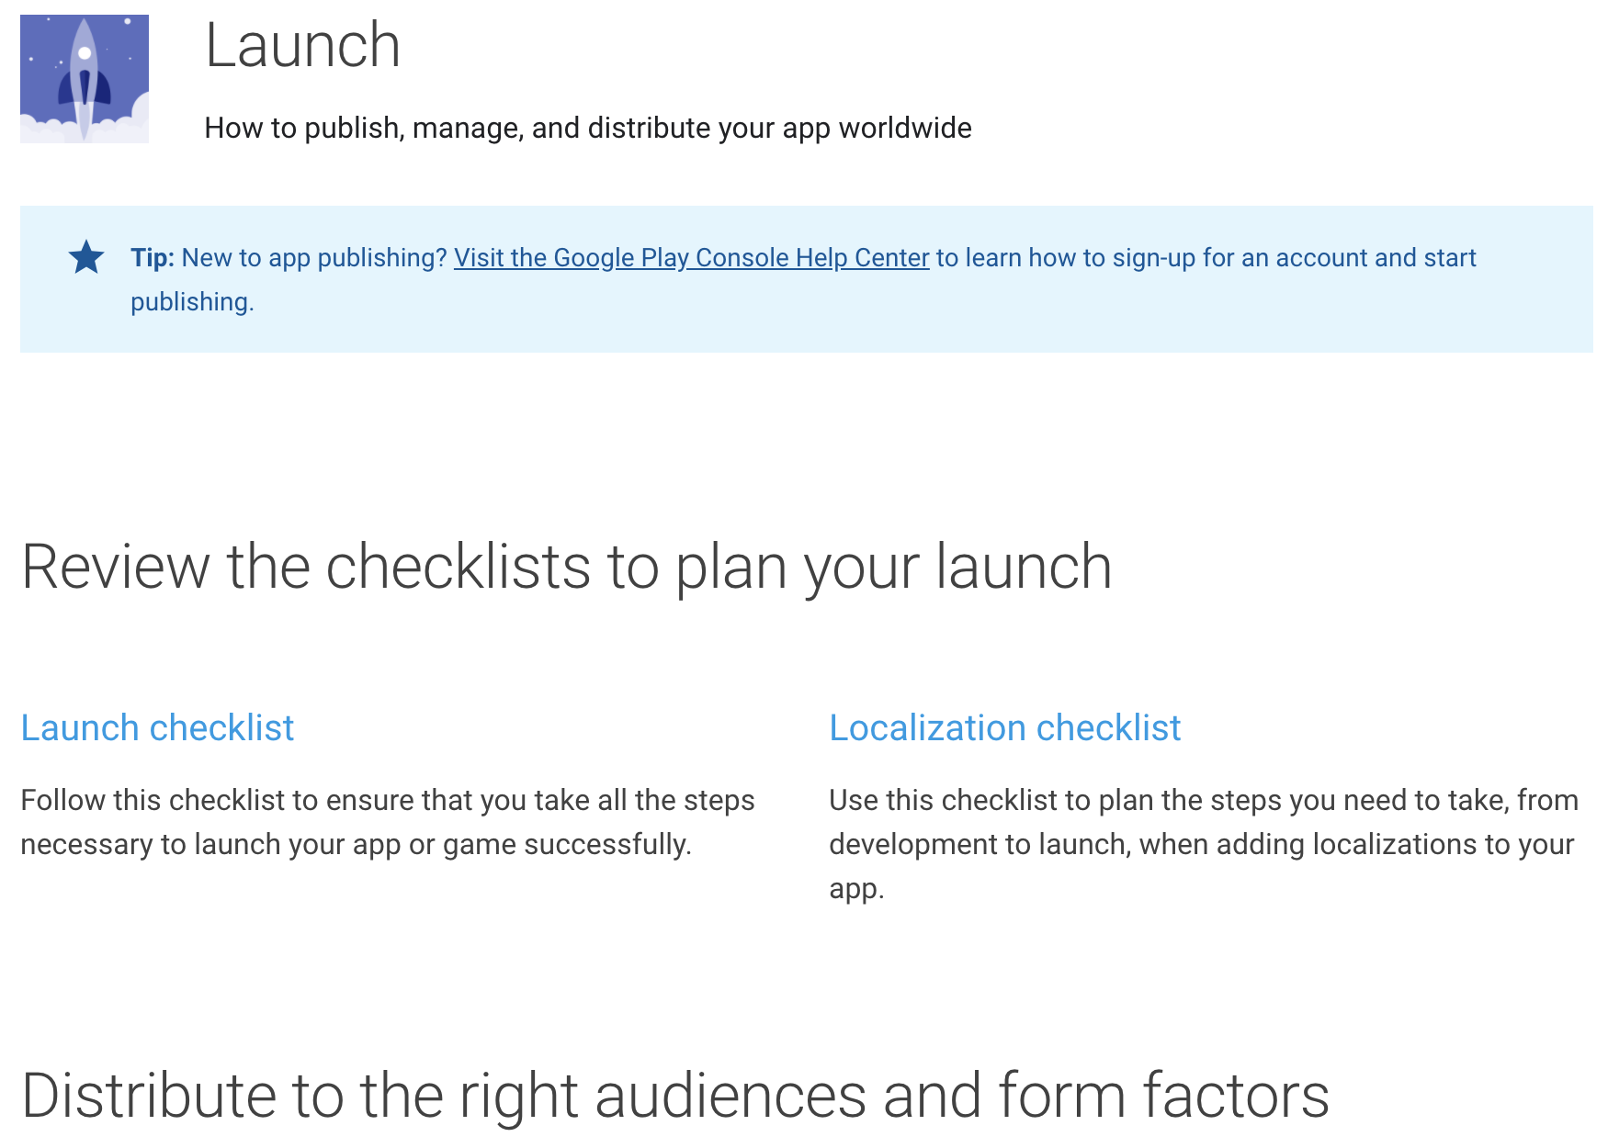
Publishing to the Google Play Store
For detailed instructions on publishing your app to the Google Play Store, see the Google Play launch documentation.

Slide 21
Updating the app’s version number
The default version number of the app is 1.0.0.
To update it, navigate to the pubspec.yaml file and update the following line:
version: 1.0.0+1
The version number is three numbers separated by dots, such as 1.0.0 in the example above, followed by an optional build number such as 1 in the example above, separated by a +.

Slide 22
Android release FAQ
When should I build app bundles versus APKs?
The Google Play Store recommends that you deploy app bundles over APKs because they allow a more efficient delivery of the application to your users.
However, if you’re distributing your application by means other than the Play Store, an APK may be your only option.

Slide 23
What is a fat APK?
A fat APK is a single APK that contains binaries for multiple ABIs embedded within it.
This has the benefit that the single APK runs on multiple architectures and thus has wider compatibility, but it has the drawback that its file size is much larger, causing users to download and store more bytes when installing your application.

Slide 24
What are the supported target architectures?
When building your application in release mode, Flutter apps can be compiled for armeabi-v7a (ARM 32-bit), arm64-v8a (ARM 64-bit), and x86-64 (x86 64-bit).
Flutter does not currently support building for x86 Android (See Issue 9253).

Slide 25
How do I build a release from within Android Studio?
In Android Studio, open the existing android/ folder under your app’s folder. Then, select build.gradle (Module: app) in the project panel:

Slide 26
Next, select the build variant. Click Build > Select Build Variant in the main menu. Select any of the variants in the Build Variants panel (debug is the default):
The resulting app bundle or APK files are located in build/app/outputs within your app’s folder.

Slide 27
Build and release an iOS app
Notes:
StatelessWidget is used for immutable elements that only rely on the object configuration information
StatefulWidget is used for elements that can dynamically change based on state-changes in the system
Everytime that state changes, setChange() is called by the object

Slide 28
Preliminaries
Before beginning the process of releasing your app, ensure that it meets Apple’s App Review Guidelines.
In order to publish your app to the App Store, you must first enroll in the Apple Developer Program.
You can read more about the various membership options in Apple’s Choosing a Membership guide.

Slide 29
Register your app on App Store Connect
Manage your app’s life cycle on App Store Connect (formerly iTunes Connect). You define your app name and description, add screenshots, set pricing, and manage releases to the App Store and TestFlight.
Registering your app involves two steps: registering a unique Bundle ID, and creating an application record on App Store Connect.
For a detailed overview of App Store Connect, see the App Store Connect guide.

Slide 30
Register a Bundle ID
Open the App IDs page of your developer account.
Click + to create a new Bundle ID.
Enter an app name, select Explicit App ID, and enter an ID.
Select the services your app uses, then click Continue.
On the next page, confirm the details and click Register to register your Bundle ID.

Slide 31
Create an application record on App Store Connect
Open App Store Connect in your browser.
On the App Store Connect landing page, click My Apps.
Click + in the top-left corner of the My Apps page, then select New App.
Fill in your app details in the form that appears. In the Platforms section, ensure that iOS is checked. Since Flutter does not currently support tvOS, leave that checkbox unchecked. Click Create.
Navigate to the application details for your app and select App Information from the sidebar.
In the General Information section, select the Bundle ID you registered in the preceding step.

Slide 32
Review Xcode project settings
Navigate to your target’s settings in Xcode:
In Xcode, open Runner.xcworkspace in your app’s ios folder.
To view your app’s settings, select the Runner project in the Xcode project navigator. Then, in the main view sidebar, select the Runner target.
Select the General tab.

Slide 33
The General tab of your project settings should resemble the following:

Slide 34
Updating
The app’s name: In the main view sidebar, select the Info.plist file. Rename the Bundle name field.
The app’s version number: The default version number of the app is 1.0.0. To update it, navigate to the pubspec.yaml file and update the following line:
version: 1.0.0+1
The version number is three numbers separated by dots, such as 1.0.0 in the example above, followed by an optional build number such as 1 in the example above, separated by a +.

Slide 35
Add an app icon
When a new Flutter app is created, a placeholder icon set is created. This step covers replacing these placeholder icons with your app’s icons:
Review the iOS App Icon guidelines.
In the Xcode project navigator, select Assets.xcassets in the Runner folder. Update the placeholder icons with your own app icons.
Verify the icon has been replaced by running your app using flutter run.

Slide 36
Create a build archive
This step covers creating a build archive and uploading your build to App Store Connect.
During development, you’ve been building, debugging, and testing with debug builds.
Obfuscating your code involves adding a couple flags to your build command.

Slide 37
On the command line, follow these steps in your application directory:
Run flutter build ios to create a release build (flutter build defaults to --release).
To ensure that Xcode refreshes the release mode configuration, close and re-open your Xcode workspace. For Xcode 8.3 and later, this step is not required.

Slide 38
In Xcode, configure the app version and build:
In Xcode, open Runner.xcworkspace in your app’s ios folder.
Select Product > Scheme > Runner.
Select Product > Destination > Generic iOS Device.
Select Runner in the Xcode project navigator, then select the Runner target in the settings view sidebar.
In the Identity section, update the Version to the user-facing version number you wish to publish.
In the Identity section, update the Build identifier to a unique build number used to track this build on App Store Connect.

Slide 39
Finally, create a build archive and upload it to App Store Connect:
Select Product > Archive to produce a build archive.
In the sidebar of the Xcode Organizer window, select your iOS app, then select the build archive you just produced.
Click the Validate App button. If any issues are reported, address them and produce another build. You can reuse the same build ID until you upload an archive.
After the archive has been successfully validated, click Distribute App.

Slide 40
Release your app on TestFlight
TestFlight allows developers to push their apps to internal and external testers. This optional step covers releasing your build on TestFlight.
Navigate to the TestFlight tab of your app’s application details page on App Store Connect.
Select Internal Testing in the sidebar.
Select the build to publish to testers, then click Save.
Add the email addresses of any internal testers. You can add additional internal users in the Users and Roles page of App Store Connect, available from the dropdown menu at the top of the page.

Slide 41
Release your app to the App Store
When you’re ready to release your app to the world, follow these steps to submit your app for review and release to the App Store:
Select Pricing and Availability from the sidebar of your app’s application details page on App Store Connect and complete the required information.
Select the status from the sidebar. If this is the first release of this app, its status is 1.0 Prepare for Submission. Complete all required fields.
Click Submit for Review.

Slide 42
Build and release a web app
Notes:
StatelessWidget is used for immutable elements that only rely on the object configuration information
StatefulWidget is used for elements that can dynamically change based on state-changes in the system
Everytime that state changes, setChange() is called by the object

Slide 43
Topics
During a typical development cycle, you test an app using flutter run -d chrome (for example) at the command line.
This page helps you prepare a release version of your app and covers the following topics:
Handling images on the web
Choosing a web renderer
Minification
Building the app for release
Deploying to the web

Slide 44
Handling images on the web
The web supports the standard Image widget to display images.
For more information, see Displaying images on the web.

Slide 45
Choosing a web rendere
By default, the flutter build and flutter run commands use the auto choice for the web renderer.
This means that your app runs with the HTML renderer on mobile browsers and CanvasKit on desktop browsers.
For more information, see Web renderers.

Slide 46
Minification
Minification is handled for you when you create a release build.
A debug build of a web app is not minified and tree shaking has not been performed.
A profile build is not minified and tree shaking has been performed.
A release build is both minified and tree shaking has been performed.

Slide 47

Building the app for release
Build the app for deployment using the flutter build web command.
You can also choose which renderer to use by using the --web-renderer option (See Web renderers).
This generates the app, including the assets, and places the files into the /build/web directory of the project.

Slide 48
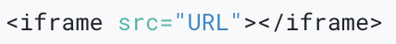
Embedding a Flutter app into an HTML page
You can embed a Flutter web app, as you would embed other content, in an iframe tag of an HTML file.
In the following example, replace “URL” with the location of your HTML page:

Slide 49
Deploying to the web
When you are ready to deploy your app, upload the release bundle to Firebase, the cloud, or a similar service.
Here are a few possibilities, but there are many others:
Firebase Hosting
GitHub Pages
Google Cloud Hosting

Slide 50
Thank you!
Wenxuan Shi
College of Software, Nankai University
Email: shiwx@nankai.edu.cn
Wechat: 13920561100

